Slide 1


Design and Development of an Intelligent Real-Time Traffic Flow Prediction and Congestion Analysis System Using Long Short-Term Memory (LSTM) Deep Learning Networks
DEPARTMENT OF COMPUTER SCIENCE AND ENGINEERING
PRESENTED BY
Y. JOHNSON (REG NO:212922104025)
M. EVARENCE BESKI (REG NO:212922104016)
FINAL YEAR B.E (CSE)
GUIDED BY
Ms. A. Sunitha M.E, (Ph.d) AP/CSE

Slide 2
ABSTRACT
Traffic congestion is a major problem in urban areas, causing delays, fuel wastage, and pollution. Accurate real-time traffic prediction is essential for smart transportation systems.
Traditional statistical and machine learning models fail to effectively capture long-term temporal dependencies in traffic time-series data.
This project proposes an intelligent real-time traffic flow prediction and congestion analysis system using Long Short-Term Memory (LSTM) deep learning networks to improve forecastindecisionsg accuracy.
The proposed system predicts short-term traffic flow and classifies congestion levels, helping authorities and commuters make better route

Slide 3
OBJECTIVE
To develop and implement an LSTM-based real-time traffic flow prediction and congestion analysis system that improves short-term forecasting accuracy using time-series traffic data.

Slide 4
EXISTING SYSTEM
Traffic prediction mainly uses statistical models like ARIMA and traditional machine learning algorithms such as Linear Regression and SVM.
These models cannot effectively capture long-term temporal dependencies present in traffic time-series data.
Prediction accuracy decreases during peak hours and dynamic traffic conditions.
Most existing systems are not optimized for real-time congestion analysis in smart transportation environments

Slide 5
PROPOSED SYSTEM
The system uses Long Short-Term Memory (LSTM) deep learning networks to model sequential traffic data.
It captures long-term temporal patterns and improves short-term traffic flow forecasting accuracy.
The model performs real-time traffic prediction and classifies congestion levels (Low, Medium, High).
The system is scalable and suitable for intelligent transportation and smart city applications.

Slide 6
LITERATURE SURVEY

Slide 7
Optimizing Traffic Speed Prediction Using a Multi-Objective Genetic Algorithm-Enhanced RNN for Intelligent Transportation Systems Author: C. Swetha Priya and F. Sagayaraj Francis
This paper proposes a Multi-Objective Genetic Algorithm enhanced Recurrent Neural Network (RNN) model to optimize traffic speed prediction accuracy and model performance for intelligent transportation systems.
Advantages
Multi-objective optimization improves prediction accuracy and model efficiency simultaneously.
Enhances RNN performance by automatically selecting optimal hyperparameters.
Suitable for intelligent transportation systems requiring optimized and adaptive traffic speed prediction
Disadvantages
The integration of Genetic Algorithm with RNN increases computational complexity and processing time.
Requires careful parameter tuning for both the Genetic Algorithm and RNN to achieve optimal performance.
Higher implementation complexity compared to standard deep learning models

Slide 8
Performance and improvement of deep learning algorithms based on LSTM in traffic flow prediction Author: Wei Xu1, Eric Blancaflor , Mideth Abisado1
This paper analyzes the performance of Long Short-Term Memory (LSTM) deep learning models and proposes improvements to enhance accuracy in traffic flow prediction for intelligent transportation systems.
Advantages:
LSTM effectively captures long-term temporal dependencies in traffic time-series data.
Provides higher prediction accuracy compared to traditional statistical models.
Suitable for real-time traffic flow forecasting in intelligent transportation systems.
Disadvantages:
LSTM models require large amounts of historical traffic data for effective training.
Training deep learning models like LSTM can take longer computational time.
Model performance may decrease if traffic data contains noise or missing values.

Slide 9
A novel CNN‑GRU‑LSTM based deep learning model for accurate traffic prediction Author: Vandana Singh1, Sudip Kumar Sahana1,Vandana Bhattacharjee1
This paper proposes a hybrid deep learning architecture combining CNN, GRU, and LSTM networks to improve traffic flow prediction accuracy by capturing both spatial and temporal traffic patterns.
Advantages:
Captures both spatial features (via CNN) and temporal dependencies (via GRU and LSTM).
Provides higher prediction accuracy compared to traditional and single deep learning models.
Suitable for complex urban traffic environments with dynamic traffic variations
Disadvantages:
The hybrid CNN-GRU-LSTM model increases computational complexity and training time.
Requires large-scale traffic datasets for effective performance.
Higher implementation complexity compared to single-model approaches like LSTM alone.

Slide 10
SYSTEM REQUIREMENTS
SOFTWARE REQUIREMENTS
Operating System : Windows
Programming Language : Python
Deep Learning Framework : TensorFlow
Libraries : OpenCV, NumPy, Keras
IDE / Tool : Jupyter Notebook
HARDWARE REQUIREMENTS
Processor : Intel i5 or higher
RAM : Minimum 8 GB
Storage : 256 GB HDD / SSD
GPU (Optional) : NVIDIA GPU for faster training

Slide 11
ARCHITECTURE DIAGRAM
User
Presentation Layer
User interface
Traffic Visualization
Prediction Display
Application Layer
Traffic Prediction
Congestion Analysis
Real Time Monitoring
Intelligent layer
LSTM Deep Learning Model
Model Training
Feature Selection
Output Layer
Predicted Traffic Flow
Congestion Status
Visualization Reports
Data Layer
Traffic Dataset
Weather Data
Historical Traffic Records
Data processing Layer
Data Preprocessing
Null Value Handling
Data Normalization
Admin Dashboard

Slide 12
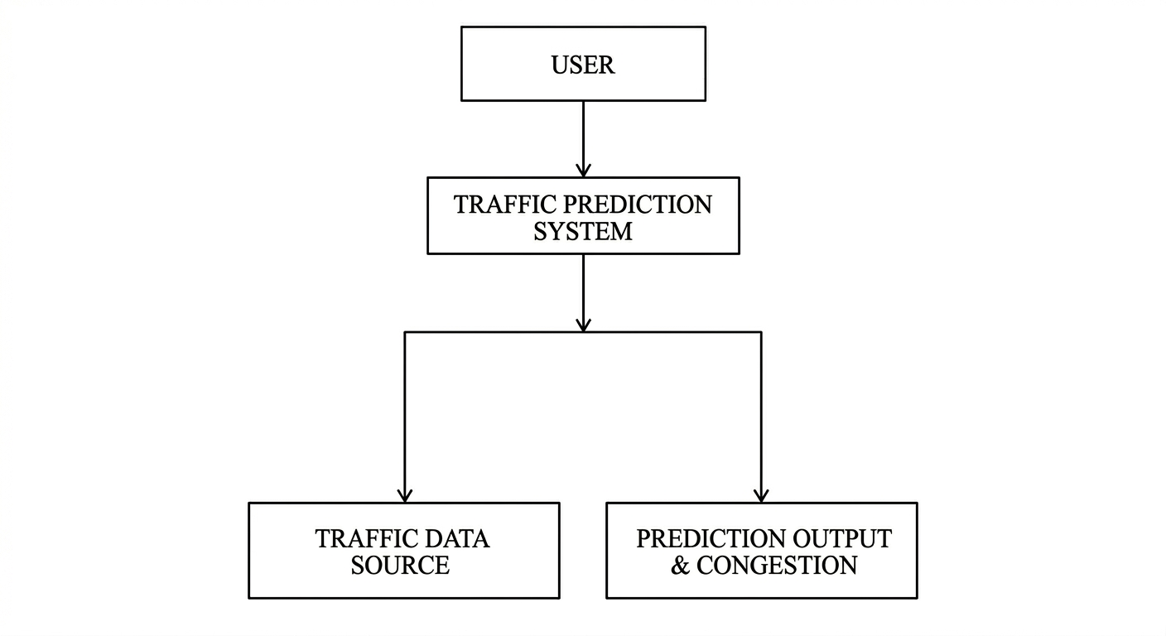
DATA FLOW DIAGRAM LEVEL 0
REQUEST FOR TRAFFIC PREDICTION

Slide 13
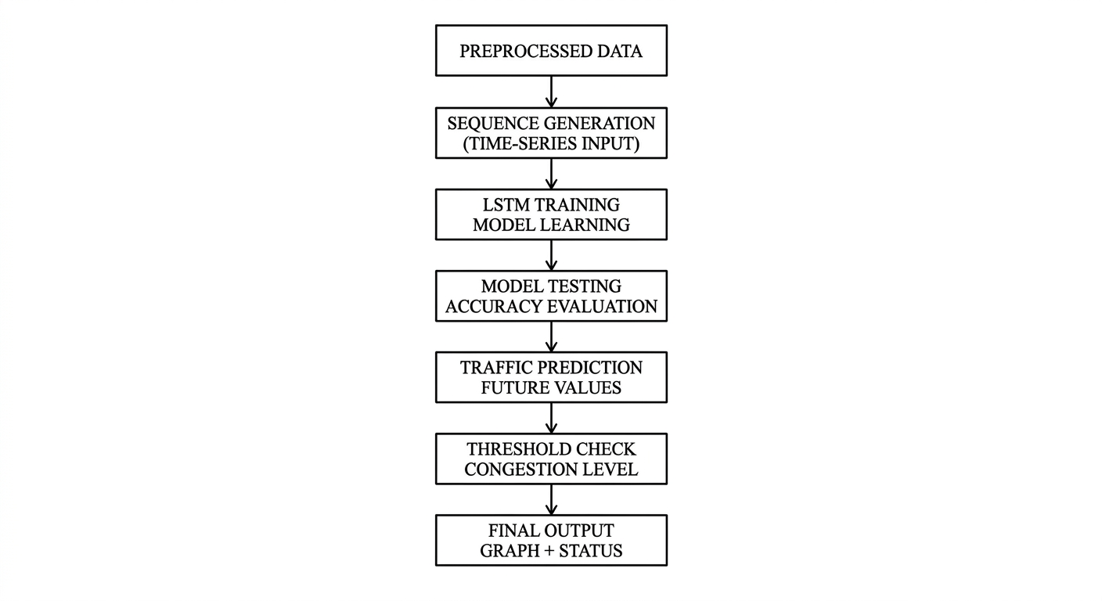
DATA FLOW DIAGRAM LEVEL 1

Slide 14
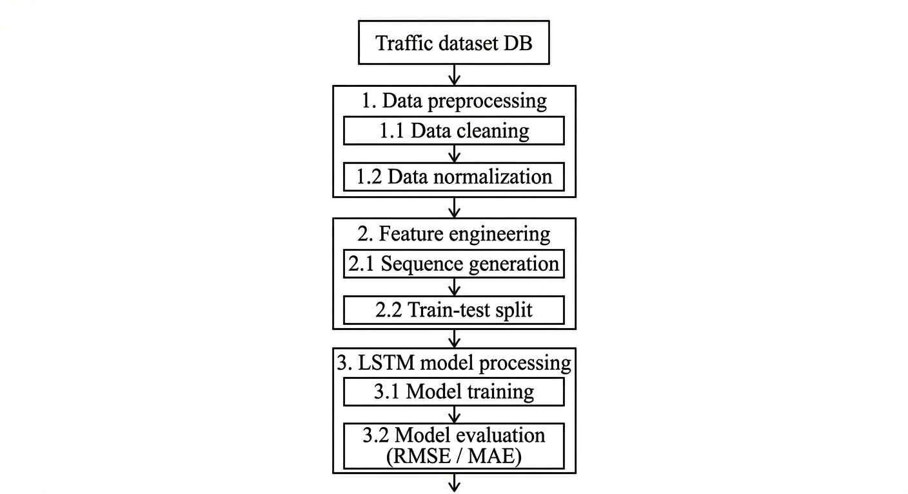
DATA FLOW DIAGRAM LEVEL 2

Slide 15
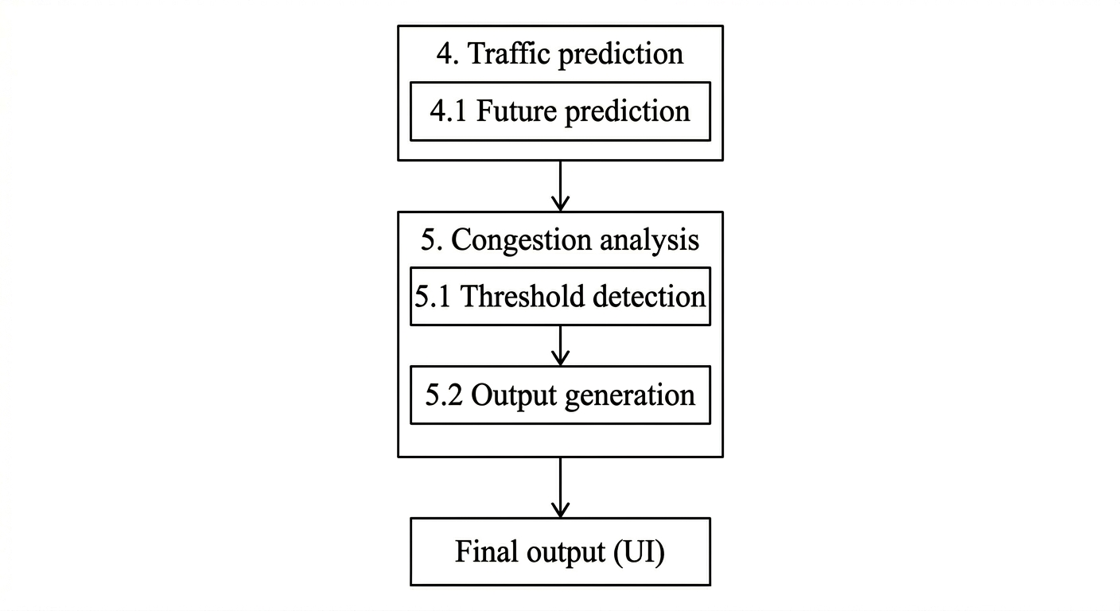
DATA FLOW DIAGRAM LEVEL 2(Contd.)

Slide 16
MODULES AND MODULES DESCRIPTION

Slide 17
MODULES
1. Data Collection Module
2. Data Preprocessing Module
3. Feature Engineering Module
4. LSTM Model Development Module
5. Traffic Prediction Module
6. Congestion Analysis And Visualization Module

Slide 18
1.DATA COLLECTION MODULE
Collect historical traffic flow data from public traffic datasets or sensors.
Gather time-based traffic information such as vehicle count, speed, and timestamps.
Store collected data in a structured format for further processing.
Traffic Data Sources
Data Accquisition
Raw Data Storage

Slide 19
2. DATA PREPROCESSING MODULE
Remove missing values and inconsistent traffic records.
Normalize traffic data to improve model training performance.
Convert raw traffic data into time-series sequences suitable for prediction.
Raw Traffic Data
Data Cleaning
Missing Value Handle
Data Normalization

Slide 20
3. FEATURE ENGINEERING MODULE
Extract important features such as traffic volume, time intervals, and day patterns.
Create input sequences required for the LSTM model.
Split the dataset into training and testing sets.
Preprocessed Data
Time-Series Convert
Sequence Generation
Train-Test Spilt

Slide 21
4. LSTM MODEL DEVELOPMENT MODULE
Design the Long Short-Term Memory (LSTM) neural network architecture.
Train the model using historical traffic data to learn temporal patterns.
Optimize model parameters to improve prediction accuracy
Input Sequences
LSTM Model Training
Pattern Learning
Model Evaluation

Slide 22
5.TRAFFIC PREDICTION MODULE
Use the trained LSTM model to predict future traffic flow values.
Generate short-term traffic forecasts for upcoming time intervals.
Analyze predicted traffic patterns for decision making
Trained Model
Predict Future Flow
Generate Forecast
Predicted output

Slide 23
6. CONGESTION ANALYSIS AND VISUALIZATION MODULE
Classify predicted traffic levels into congestion categories (Low, Medium, High).
Visualize prediction results using graphs and charts.
Provide insights to support intelligent traffic management.
Level Classification
Predicted Traffic
Threshold Check
Visualization

Slide 24
IMPLEMENTATION

Slide 25
IMPLEMENTATION METHODS
Zero day_Data Collection
Input
Historical traffic volume data
Output
Well-structured raw traffic dataset
Method
Traffic data is collected at regular time intervals (hourly)
Ensures sequential time-series structure for prediction
Maintains consistency and accuracy of collected data
Large volume of data used to improve model learning
Includes different traffic conditions (peak and non-peak hours)
Data is organized and stored in structured format (CSV/database)
Helps in capturing real-world traffic patterns effectively

Slide 26
IMPLEMENTATION METHODS
Zero day_ Data Preprocessing
Input
Raw traffic dataset
Output
Cleaned and structured dataset
Method
Remove missing and inconsistent values to improve data quality
Convert raw data into structured time-series format
Arrange data based on chronological order
Create sliding window sequences of 24-hour input
Ensure uniform data format for model processing
Reduce noise and unwanted variations in data
Prepare dataset suitable for training and prediction

Slide 27
IMPLEMENTATION METHODS
Zero day _Data Scaling
Input
Preprocessed dataset
Output
Scaled dataset
Method
Apply MinMax scaling to normalize data between 0 and 1
Reduce the effect of large variations in traffic values
Ensure all features are on the same scale
Improve model convergence during training
Prevent bias due to high magnitude values
Enhance stability and accuracy of LSTM predictions
Maintain consistency between training and testing data

Slide 28
IMPLEMENTATION METHODS
LSTM Model Prediction
Input
Scaled 24-hour traffic data
Output
Predicted traffic value (scaled)
Method
Reshape input data into 3D format (samples, timesteps, features)
Feed input sequence into LSTM model
LSTM captures temporal dependencies in traffic patterns
Utilizes memory cells to learn long-term relationships
Processes sequential data step-by-step for accurate prediction
Applies trained weights to generate output
Predicts next hour traffic based on past trends

Slide 29
IMPLEMENTATION METHODS
Zero day Result & Deployment
Input
Predicted scaled value
Output
Final predicted traffic value displayed
Method
Apply inverse transformation using scaler
Convert predicted value to original scale
Integrate model with Streamlit interface
Accept user input and process in real-time
Display prediction in a clear and user-friendly format
Ensure fast response for real-time usage
Enable easy interaction without technical knowledge

Slide 30
SNAPSHOTS

Slide 31
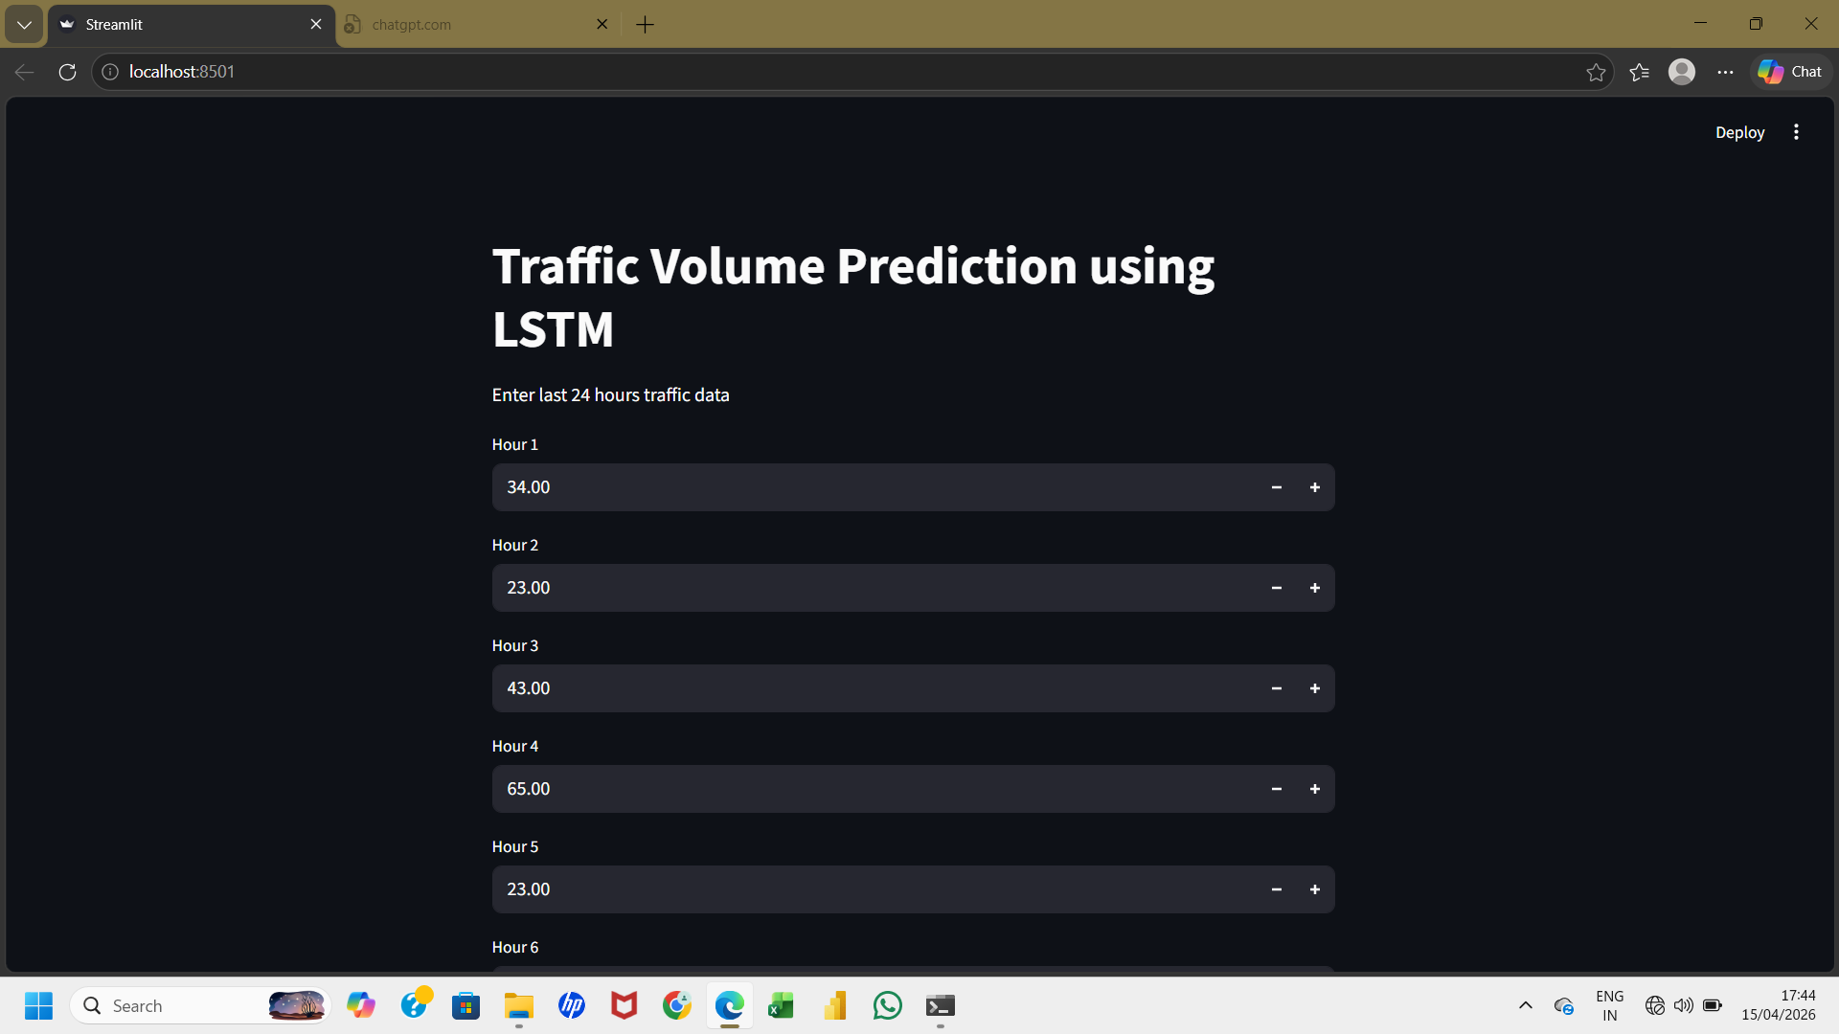
Traffic Data Input Screen-1

Slide 32
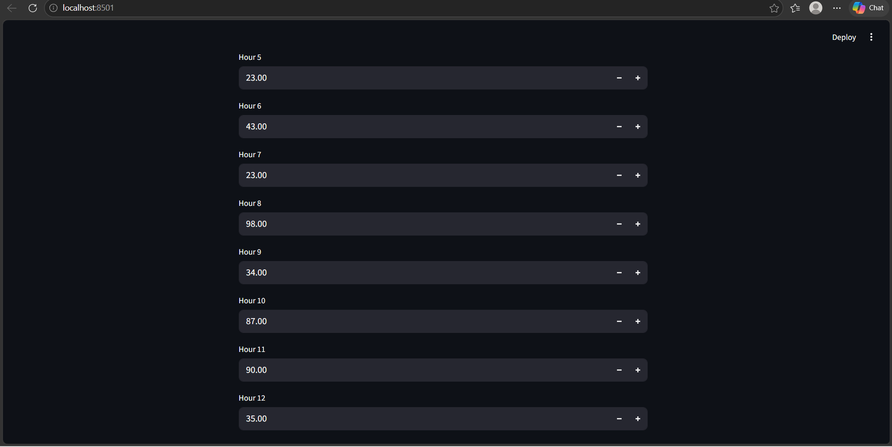
Traffic Data Input Screen-2

Slide 33
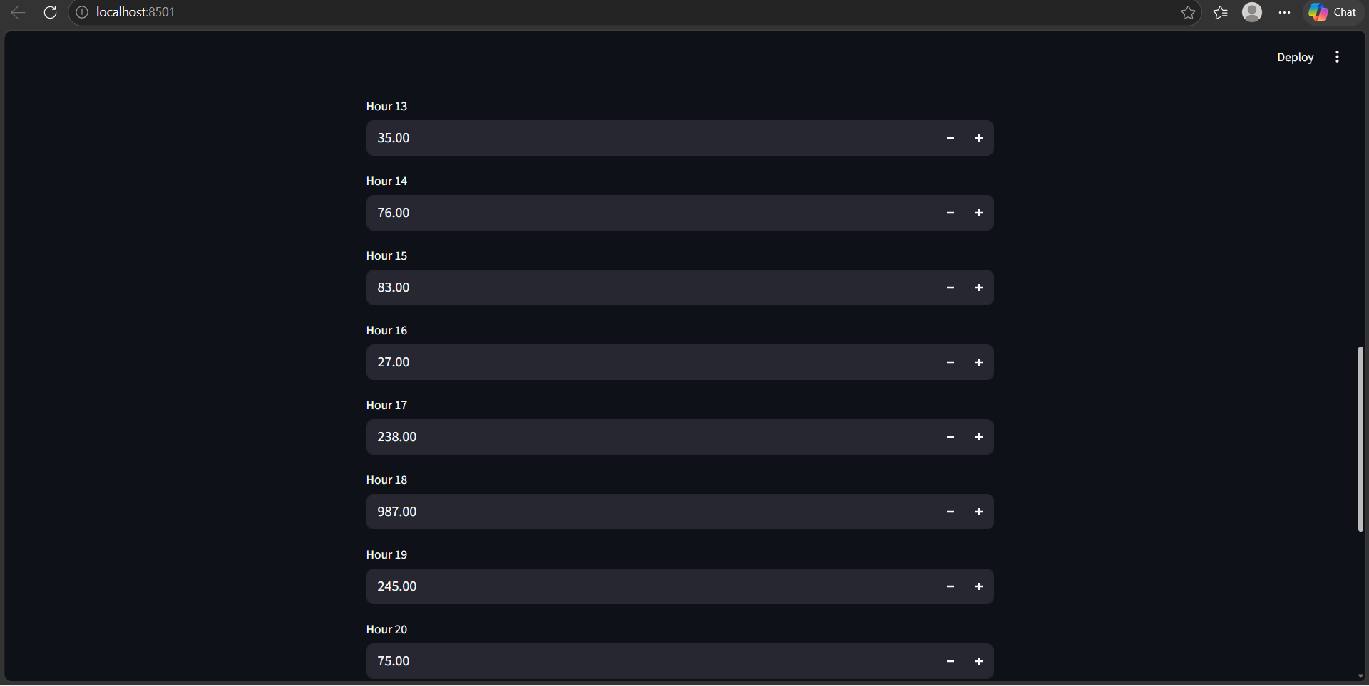
Traffic Data Input Screen-3

Slide 34
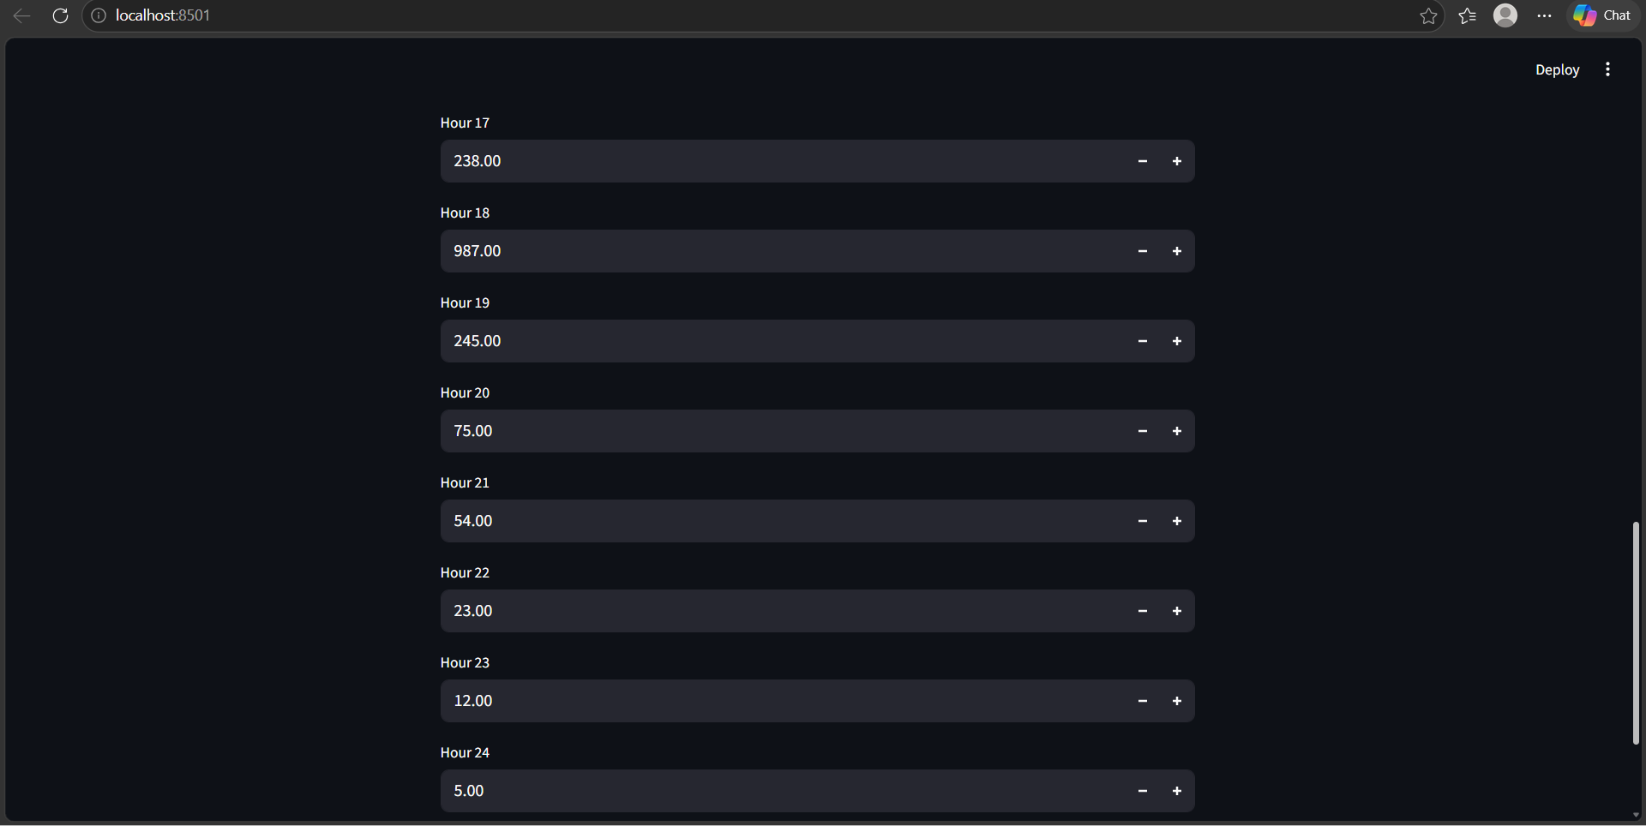
Traffic Data Input Screen-4

Slide 35
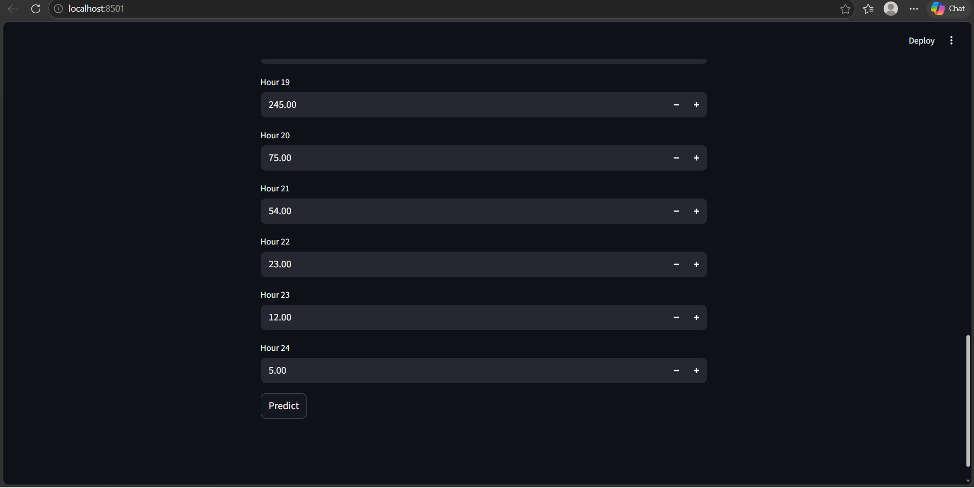
Traffic Data Input Screen-5

Slide 36
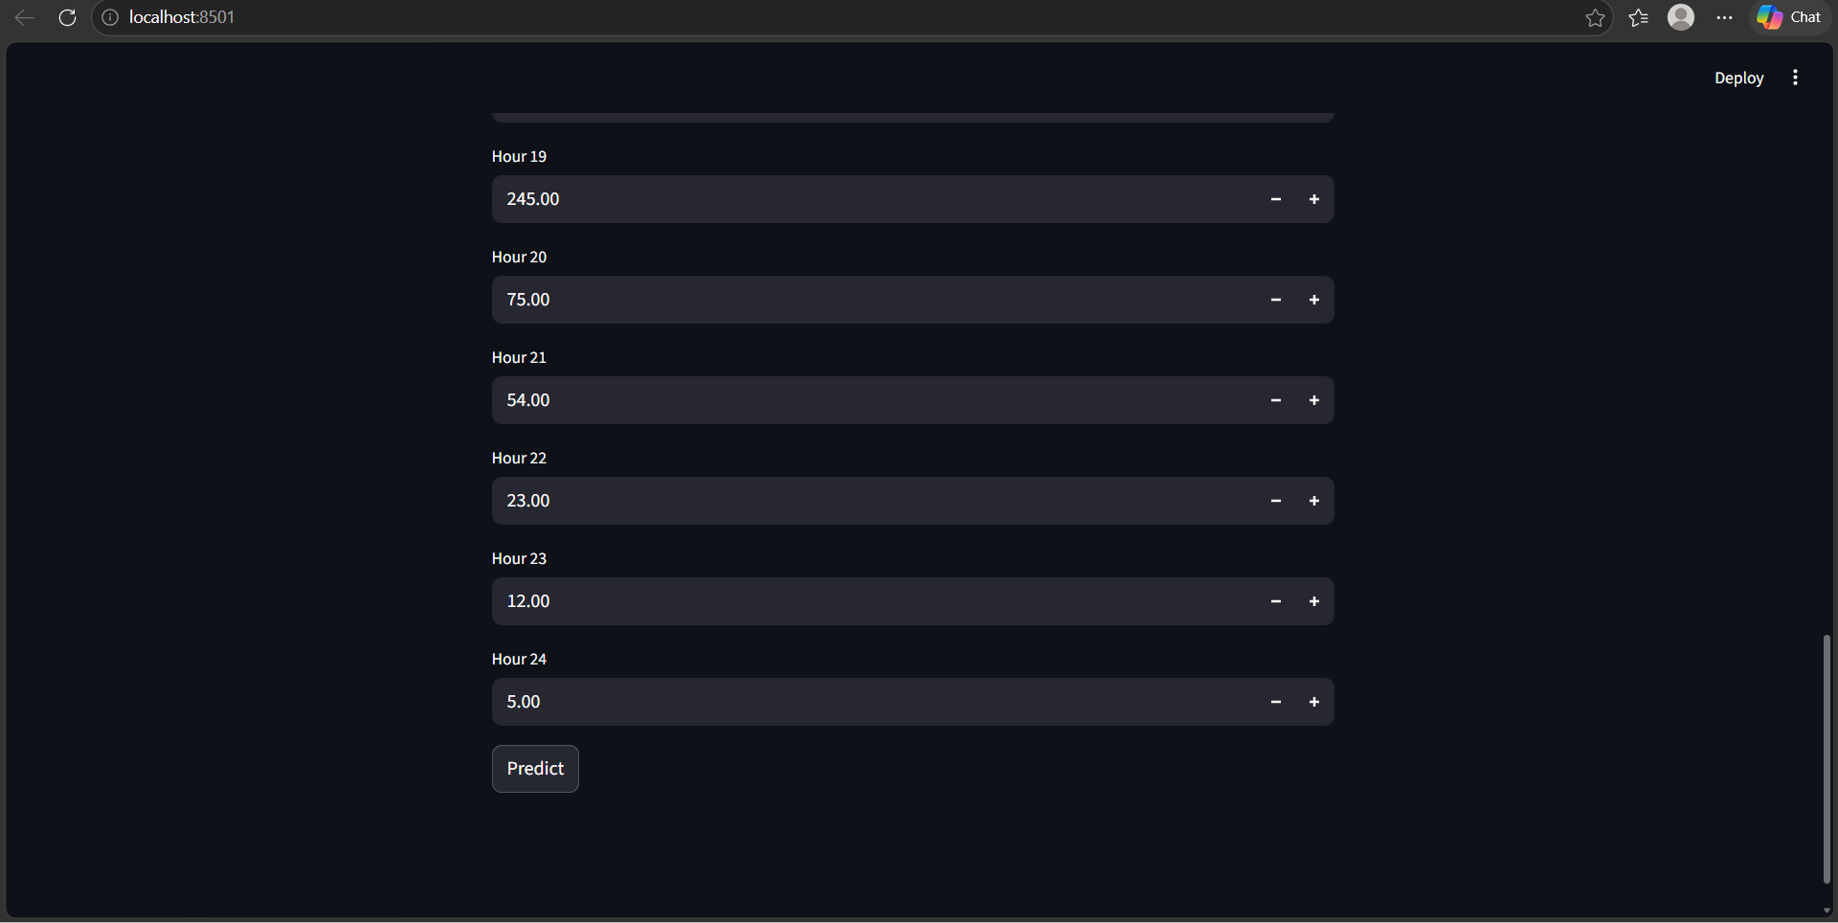
Model Processing and Prediction Initialization

Slide 37
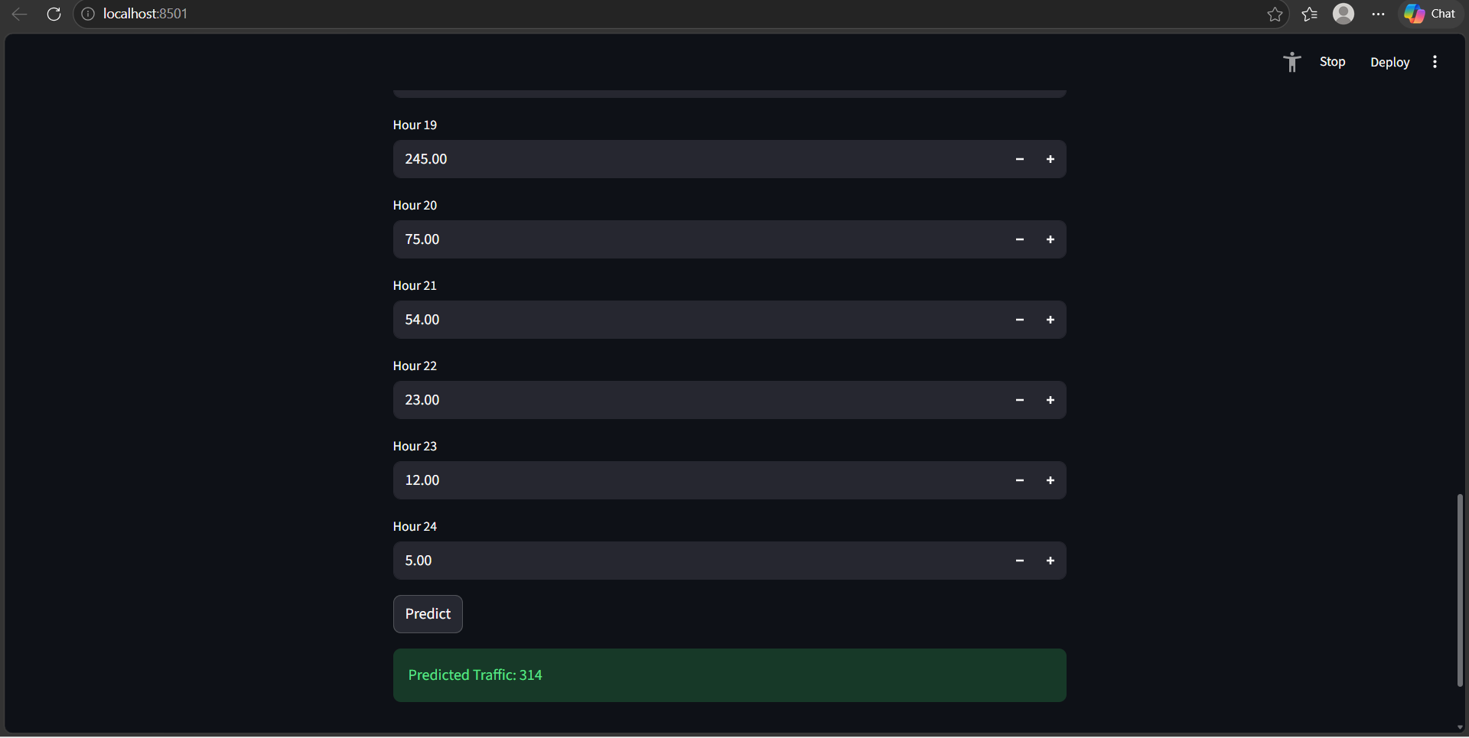
Predicted Traffic Flow Output Result

Slide 38
CONCLUSION
The proposed traffic flow prediction system using LSTM effectively captures complex and time-dependent traffic patterns.
It provides more accurate predictions compared to traditional models and performs efficient congestion analysis.
The system also enhances understanding through clear visualization.
Overall, it proves to be reliable for real-time traffic management applications.

Slide 39
FUTURE ENCHANCEMENT
The system can be improved by integrating real-time data from IoT devices and GPS for better accuracy.
Additional factors like weather, accidents, and events can be included to enhance prediction performance.
It can also be developed into a web or mobile application with route optimization features.
Future deployment in smart city environments can further improve traffic management systems

Slide 40
REFERENCES
C.Swetha Priya and F. Sagayaraj Francis, “Optimizing Traffic Speed Prediction Using a Multi-Objective Genetic Algorithm-Enhanced RNN for Intelligent Transportation Systems,” Journal of Intelligent Transportation Systems, 2024.
Wei Xu, Eric Blancaflor, and Mideth Abisado, “Performance and Improvement of Deep Learning Algorithms Based on LSTM in Traffic Flow Prediction,” International Journal of Advanced Computer Science and Applications, 2024.
Vandana Singh, Sudip Kumar Sahana, and Vandana Bhattacharjee, “A Novel CNN-GRU-LSTM Based Deep Learning Model for Accurate Traffic Prediction,” Journal of Big Data Analytics, 2024.

Slide 41
REFERENCES(Contd.)
Hochreiter, S., and Schmidhuber, J., “Long Short-Term Memory,” Neural Computation, vol. 9, no. 8, pp. 1735–1780, 1997.
Goodfellow, I., Bengio, Y., and Courville, A., Deep Learning, MIT Press, 2016.

Slide 42
THANK YOU

